Slide 1


Airline travel better than ever!
Theodore Koby-hercsky

Slide 2
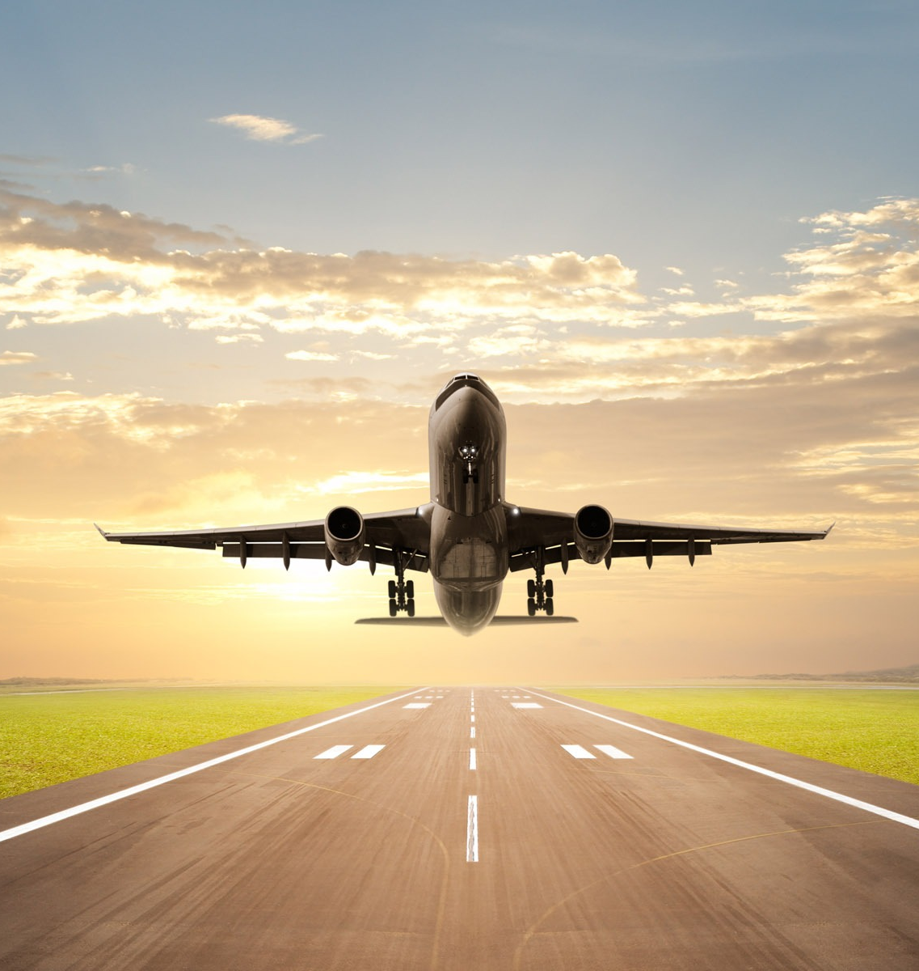
Introduction
Airline Safety: With flight departures rising "commercial aircraft are heavily ventilating the air in the cabin" providing an extra safety measure for passengers. (Haseltine)
Health Safety when Flying: Federal Aviation Administration requires an airline transport pilot to have over 1,500 hours of flight experience along with medical exam to be eligible be a pilot.

Slide 3
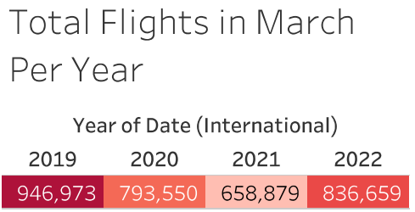
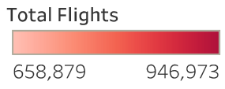
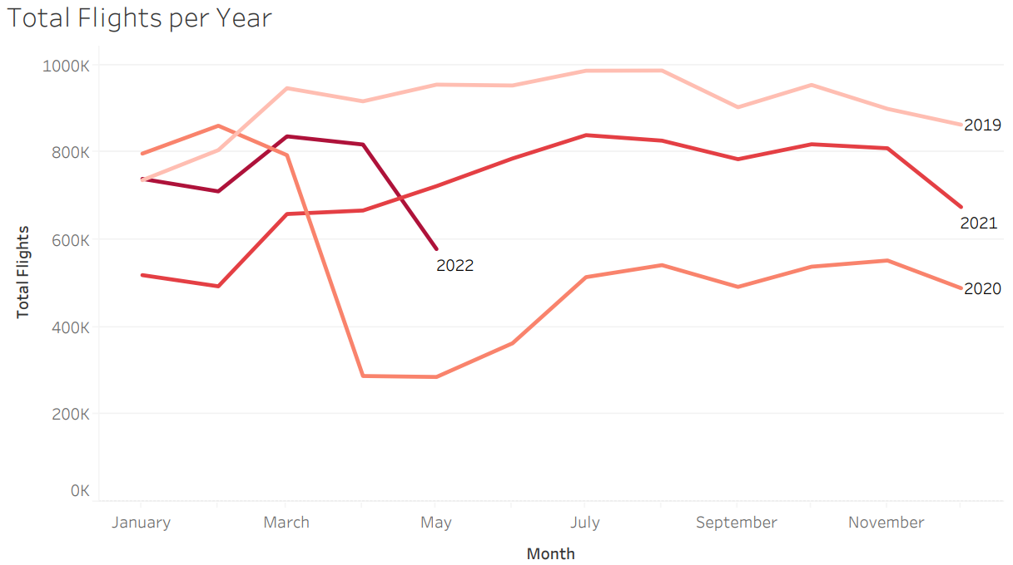
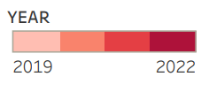
Flight Rate
This year airlines have hit the highest booking level since the start of the pandemic with bookings "running just 20% below 2019 levels." (Koenig)

Slide 4
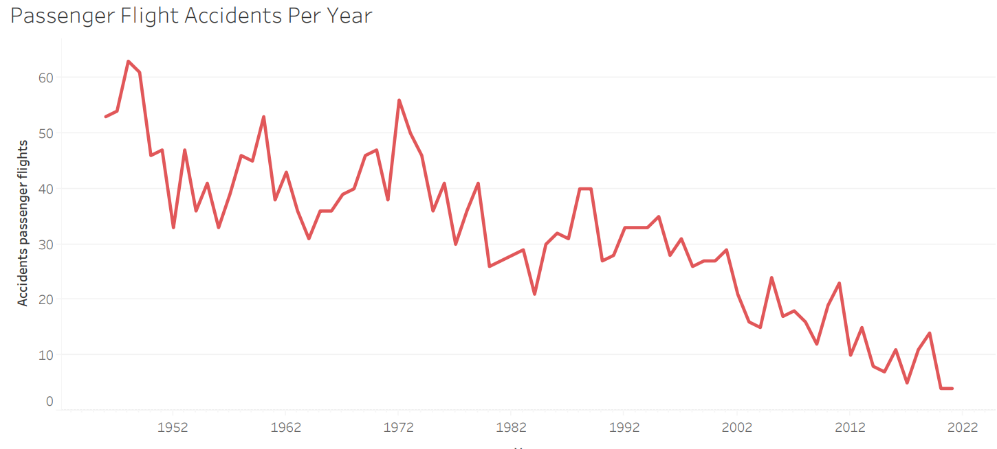
Decrease in Accidents
MIT recent study validates flying commercial has never been safer with less than " one death per 7.9 million passenger boarding's." (dizikes)

Slide 5
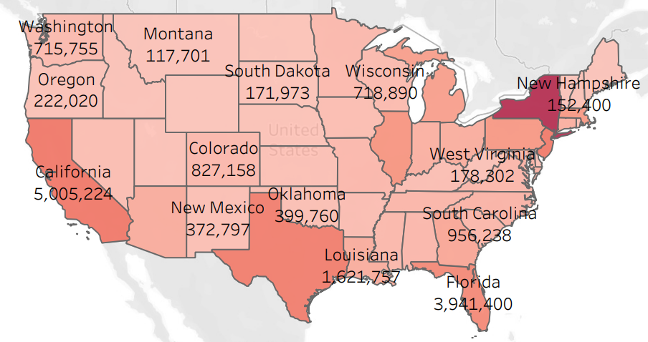
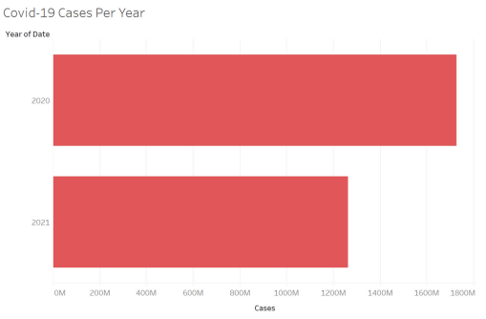
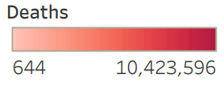
Covid-19 Cases and Deaths Rates
30% decrease in cases in 2021 and expected larger decrease by 2023. while New York, California, and Florida have seen an increase in cases but expected to decrease.

Slide 6
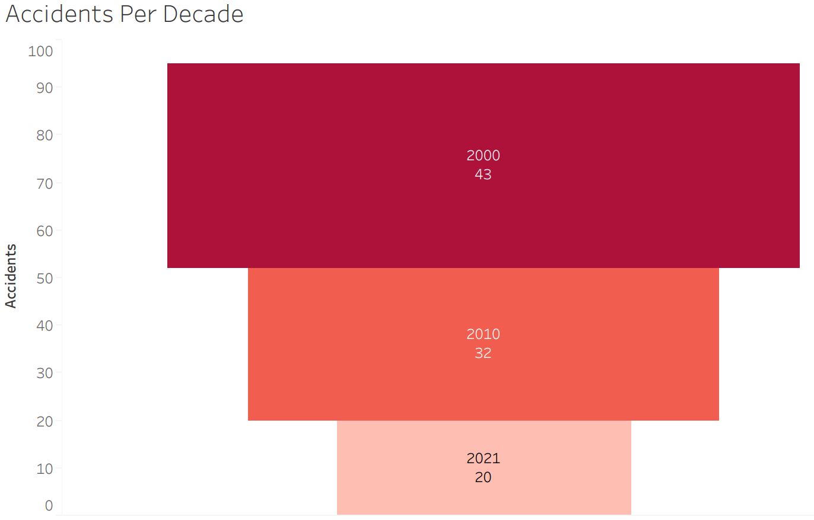
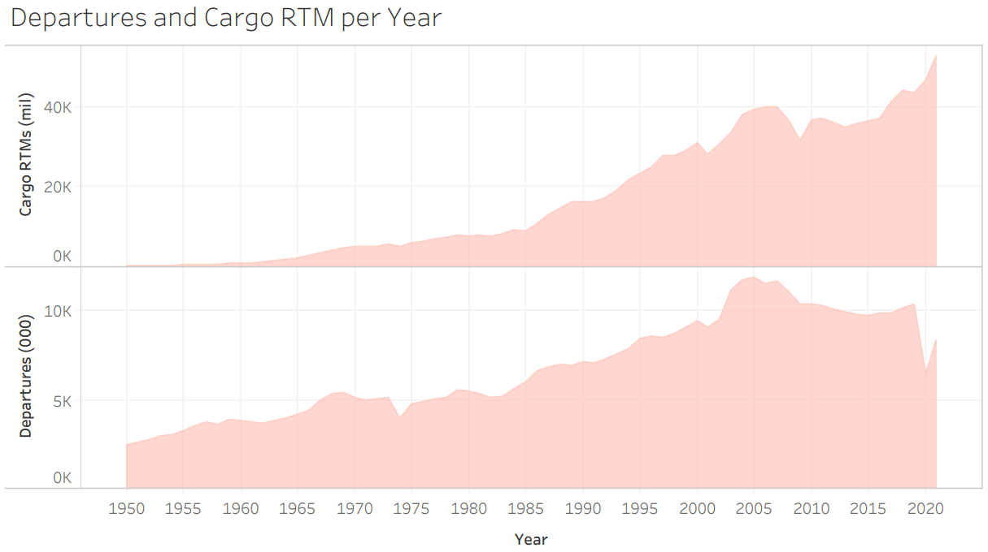

DEPARTURES AND ACCIDENTS
Global air freight market "valued at $270.2 billion in 2019 and projected to reach $376.8 billion by 2027."(Halmare)
Safety Assurance System "identified hazards to eliminate or control their associated risk“ with aviation (Safety)

Slide 7

Conclusion
Airlines are now safer than ever with only 20 accidents recorded in the past decade.
Covid-19 cases have decreased allowing airlines to no longer require proof of a negative covid test to board.

Slide 8
Reference
Haseltine, W. A. (2022, June 16). Is it safe to fly? The National Academy of Sciences, Engineering, and medicine weighs in. Forbes. Retrieved August 9, 2022, from https://www.forbes.com/sites/williamhaseltine/2022/06/14/is-it-safe-to-fly-the-nationalacademy-of-sciences-engineering-and-medicine-weighs-in/?sh=20ee80a84c3
KOENIG, D. A. V. I. D. (2021, March 15). US air travel rises to highest levels yet since pandemic hit. ABC News. Retrieved August 9, 2022, from https://abcnews.go.com/Travel/wireStory/us-airtravel-rises-highest-levels-pandemic-hit-76466659
Dizikes, P. (2020, January 23). Study: Commercial air travel is safer than ever. MIT News | Massachusetts Institute of Technology. Retrieved August 9, 2022, from https://news.mit.edu/2020/study-commercial-flights-safer-ever-0124
Halmare, M. (n.d.). Air freight market analysis, update, size, share 2021-2027. Allied Market Research. Retrieved August 9, 2022, from https://www.alliedmarketresearch.com/air-freightmarket-A06421
Safety Assurance System (SAS). Safety Assurance System (SAS) | Federal Aviation Administration. (n.d.). Retrieved August 9, 2022, from https://www.faa.gov/about/initiatives/sas

